Slide 1

[Samsung PRISM] End Review Report
Explore & Implement Image Augmentation Options
Working Team Details :
College Professor: Dr U Hariharan - hariharan.e11201@cumail.in
Students:
MATCHA PAVAN KUMAR - 20bcs6072@cuchd.in
PRIYANGSHU SARKAR - 20bcs6047@cuchd.in
ARPIT MAHAJAN - 21bcg1115@cuchd.in
Department: AIT-CSE
Date: 15 Sep 2023

Slide 2
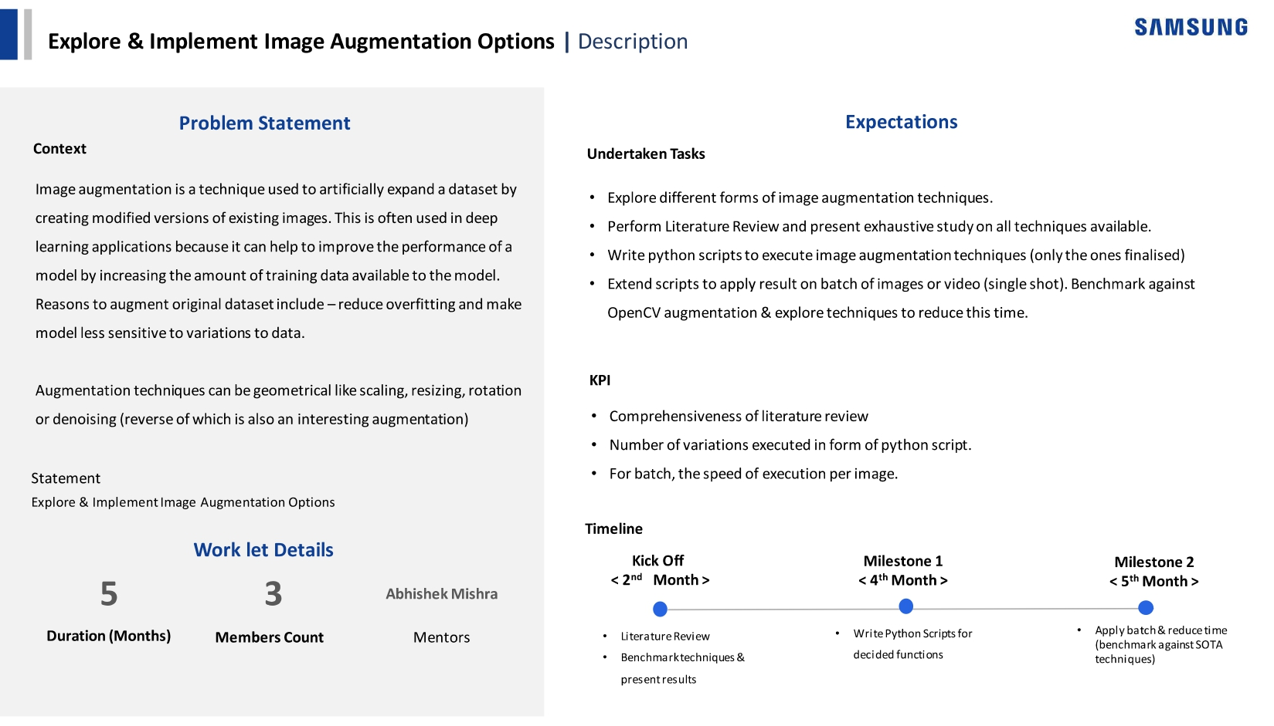
Notes:
-

Slide 3
Approach / Solution
List of Augmentation Techniques:
A. 1 – Pixel Shift + Flip
B. Activation Suppression
C. Adaptive Color Scheme
D. Tiles Shuffling
E. Low-Level Residuals
F. Texture Information Encoding

Slide 4
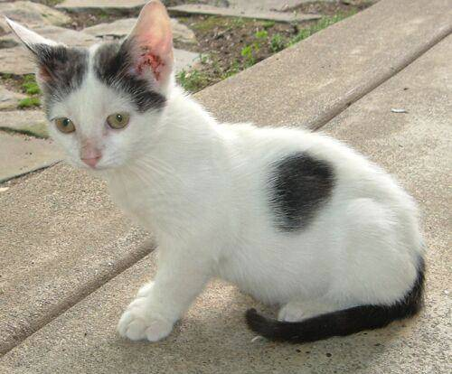
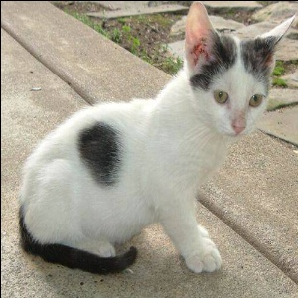
Approach / Solution
Concept Diagram :
A. 1 – Pixel Shift + Flip
This augmentation technique generates new image where all the evenly spaced pixels are shifted to the place of oddly placed pixels and vise versa. This technique is developed to address the issue of information loss due to pooling layers. To achieve efficiency in terms of memory, we need to combine it with other augmentations technique (in this case with flipping operation)
Flipping followed by 1 – pixel shift

Slide 5
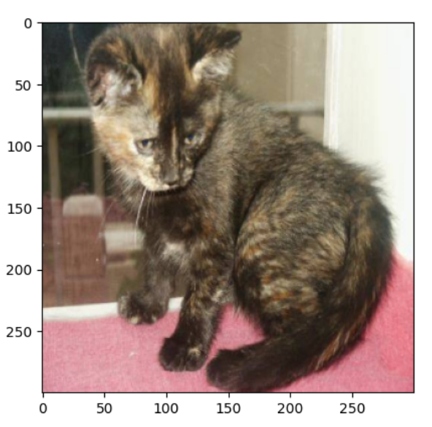
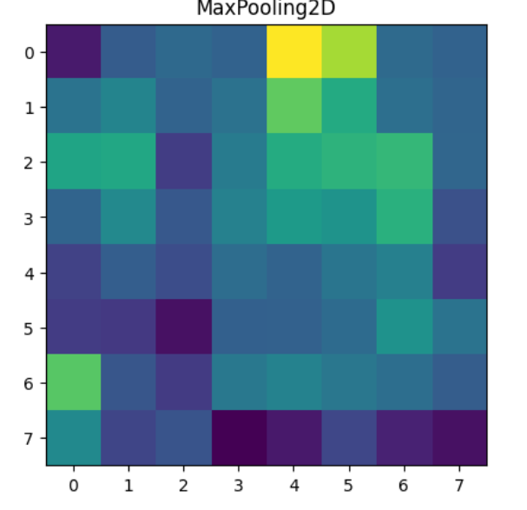
Approach / Solution
Concept Diagram :
B. Activation Suppression
Original Image
Feature map at the last layer of a base model

Slide 6
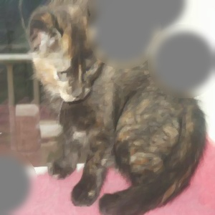
Approach / Solution
Concept Diagram :
B. Activation Suppression
Original Image
Suppressing the regions of high activation

Slide 7
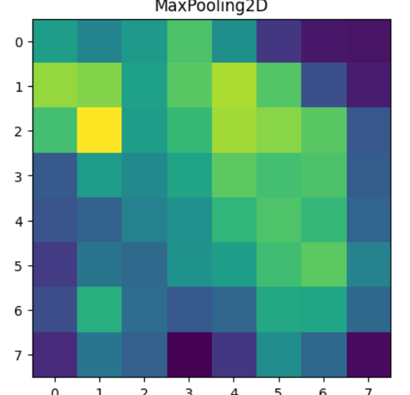
Approach / Solution
Concept Diagram :
B. Activation Suppression
This augmentation technique generates new image where highly activated regions of a base model are suppressed using neural color like gray. This acts as a regularization technique to encourage the model to no to depend on single set of features.
Original Image
New accurate feature activations

Slide 8
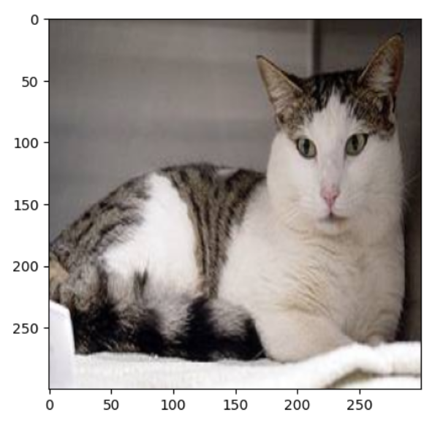
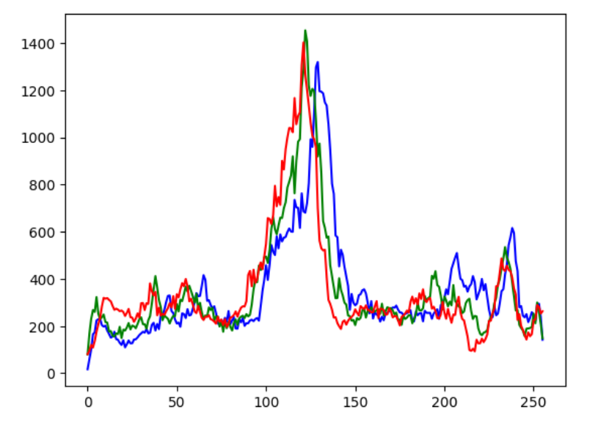
Approach / Solution
Concept Diagram :
C. Adaptive Color Scheme
Original Image
Color Distribution

Slide 9
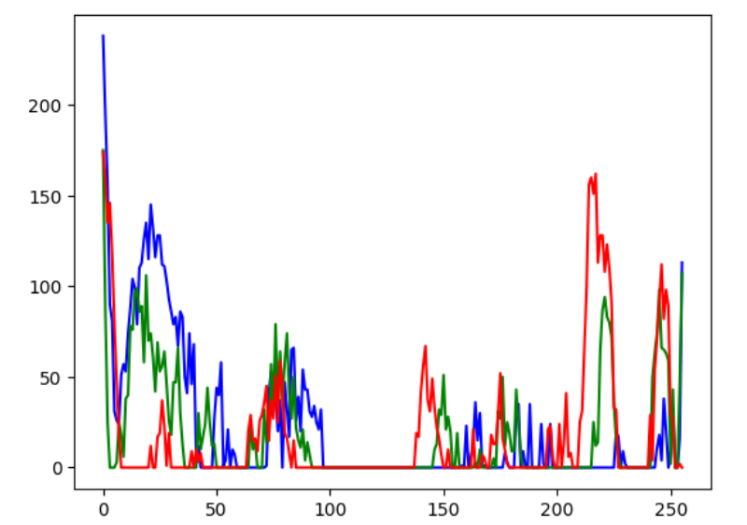
Approach / Solution
Concept Diagram :
C. Adaptive Color Scheme
Original Color Distribution
Inverted Color Distribution

Slide 10
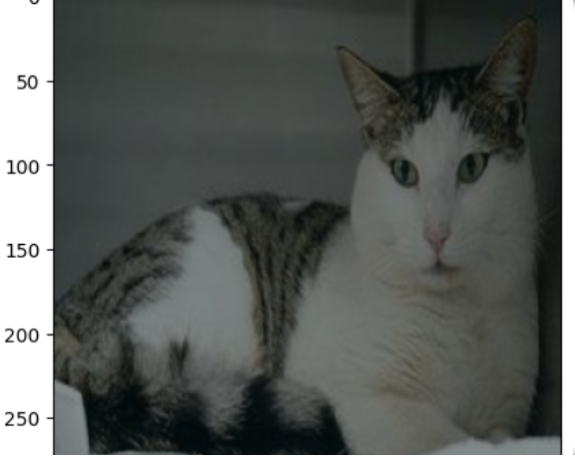
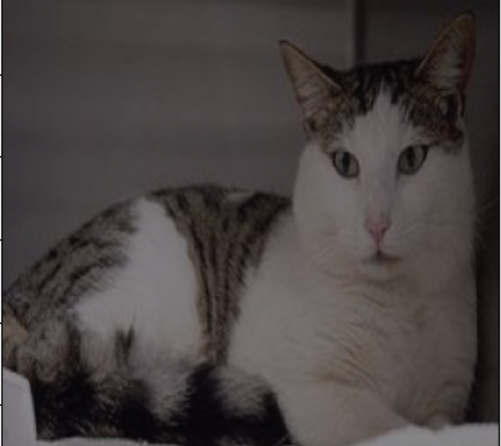
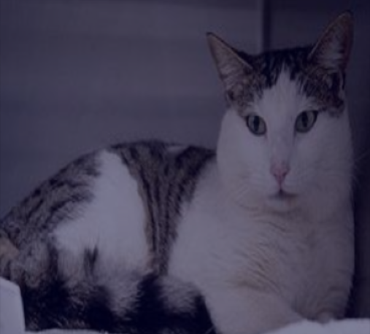
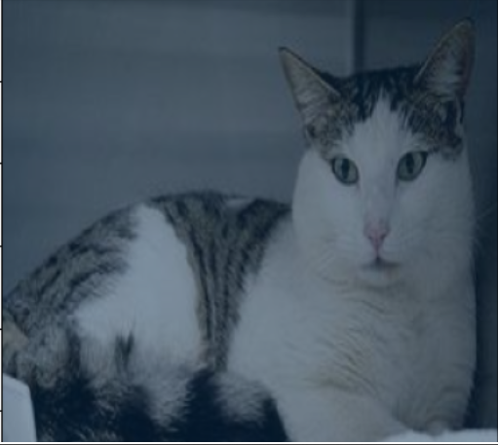
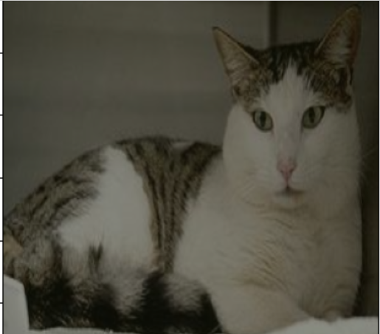
Approach / Solution
Concept Diagram :
C. Adaptive Color Scheme
This augmentation technique generates new images where each image is overlayed with a shade which is not present in the image. The intuition behind this is to provide worst case scenario to the model in terms of shades. This improves model’s robustness to color variations.

Slide 11
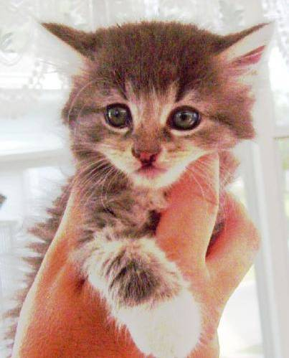
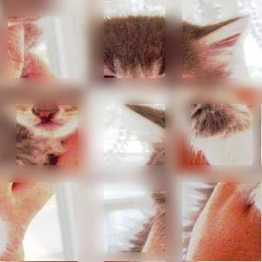
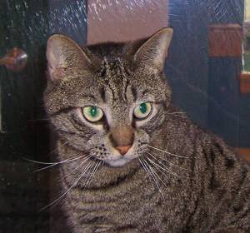
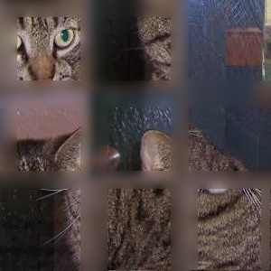
Approach / Solution
Concept Diagram :
D. Tiles Shuffling
Shuffling
This augmentation technique generates new image by splitting an image into 9 tiles and shuffling them random. This technique is developed to ensure that the CNN model understand the relative spatial information of the features.
Shuffling

Slide 12
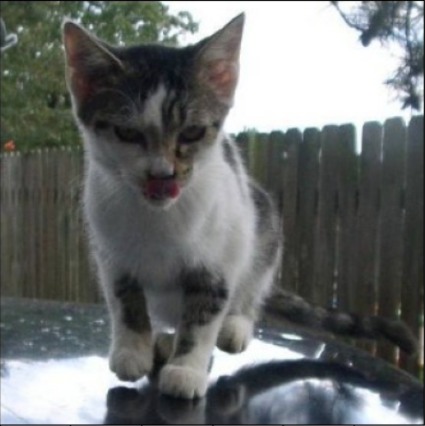
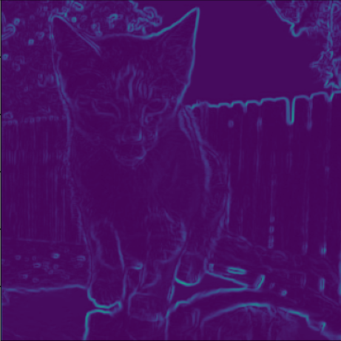
Approach / Solution
Concept Diagram :
E. Low-Level Residual
Original Image
Edges Detected at the first layer

Slide 13
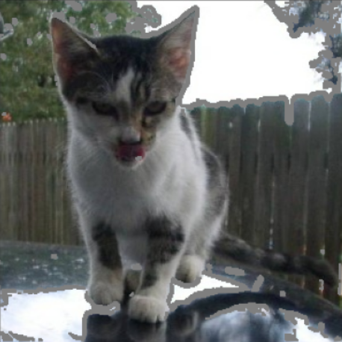
Approach / Solution
Concept Diagram :
E. Low-Level Residual
Original Image
Applying the Low-level residual augmentation

Slide 14
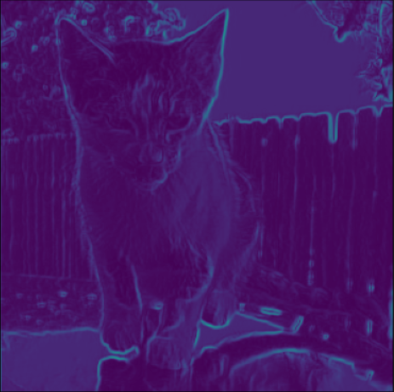
Approach / Solution
Concept Diagram :
E. Low-Level Residual
Original Image
Improved Edge Detection

Slide 15
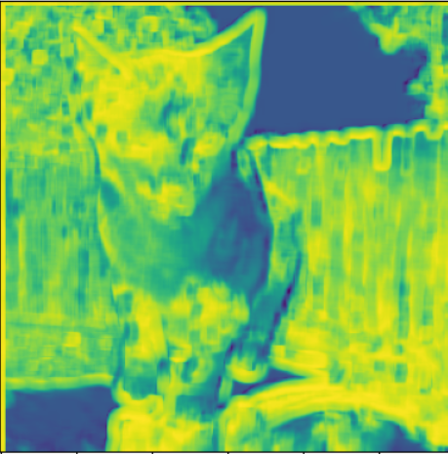
Approach / Solution
Concept Diagram :
E. Low-Level Residual
This augmentation technique generates new image where the edges detected by the base model is filled with neutral color at pixel level. By this, we will end up with the edges which are not detected by the model (the residual). So, we are training on the areas of the image where there is high chance for the model to learn new information.
Deviation Map
Edges with LLR augmentation
Edges without LLR augmentation
Structure Similarity Score: 78.94%

Slide 16
Approach / Solution
Concept Diagram :
F. Texture Information Encoder
Oddly placed pixels. Pooling happens here
Evenly placed pixels. Pooling does not happen here
Exchange of Information

Slide 17
Approach / Solution
Concept Diagram :
F. Texture Information Encoder
Oddly placed pixels. Pooling happens here
Evenly placed pixels. Pooling does not happen here
Exchange of Information

Slide 18
Approach / Solution
Concept Diagram :
F. Texture Information Encoder
Oddly placed pixels. Pooling happens here
Evenly placed pixels. Pooling does not happen here
Exchange of Information

Slide 19
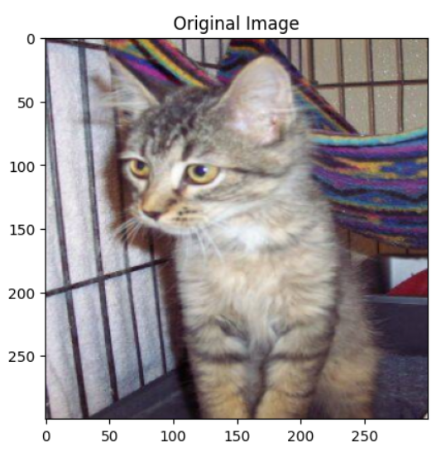
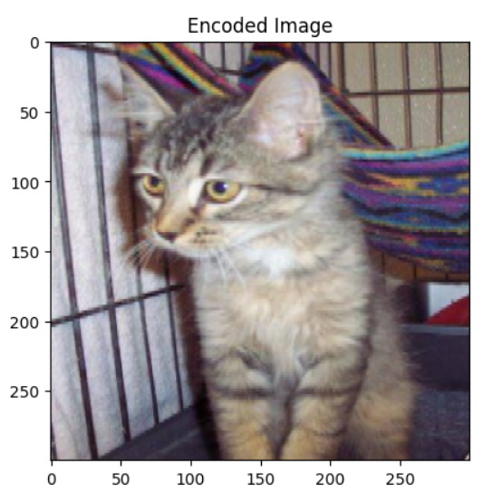
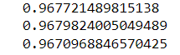
Approach / Solution
Concept Diagram :
F. Texture Information Encoder
This augmentation technique and the first one addresses the same issue (information loss due to pooling layers). This technique takes different approach. Here, we will try to encode information of evenly placed pixels onto the oddly placed pixels. This results in identical image which the texture information is encoded . This improves texture detection and makes the model robust to small translations.
Red:
Green
Blue:
Structural Similarity of each channel

Slide 20
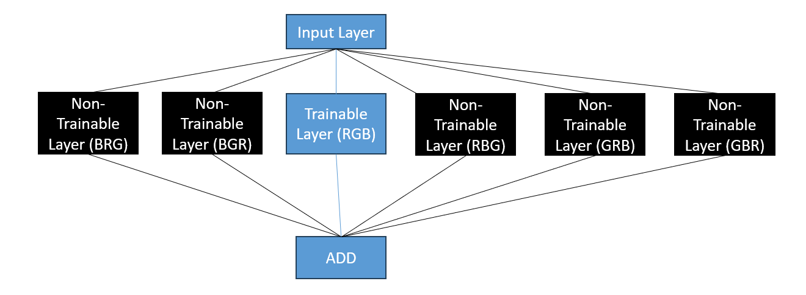
Approach / Solution
Concept Diagram :
Transferable Model (To achieve Color Invariance):
Only the center layer is trained and rest of the layers are initialized with zero weights and frozen from training.

Slide 21
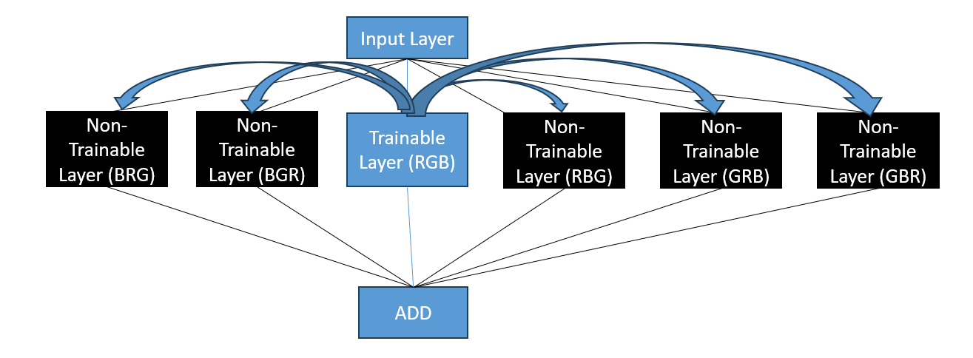
Approach / Solution
Concept Diagram :
Transferable Model (To achieve Color Invariance):
Color information is transferred from one layer to another

Slide 22
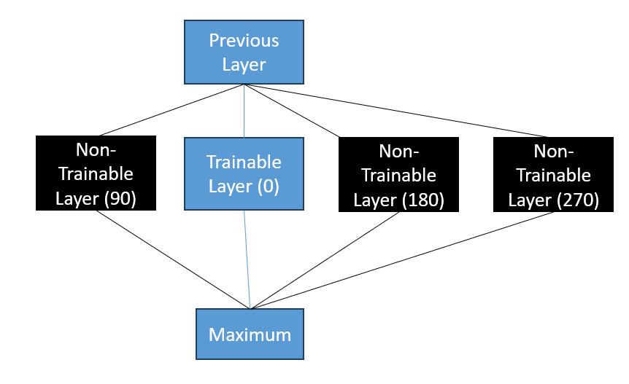
Approach / Solution
Concept Diagram :
Transferable Model (To achieve Rotational Invariance):
Only the center layer is trained and rest of the layers are initialized with zero weights and not allowed for training.

Slide 23
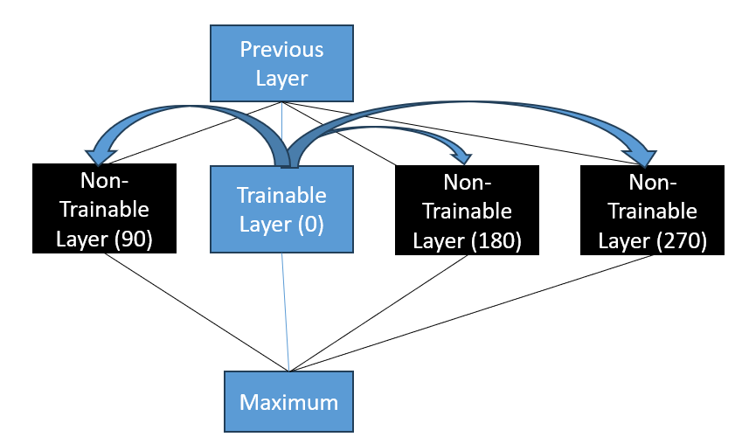
Approach / Solution
Concept Diagram :
Transferable Model (To achieve Rotational Invariance):
Rotation information is transferred from one layer to another

Slide 24
Dataset(s) Analysis / Description
Dataset Capture / Preparation / Generation :
Name: Cat vs Dog
Training Size: 3000 (1500 Cat, 1500 Dog)
Test Size: 22000 (11000 Cat, 11000 Dog)
Dataset Understanding / Analysis :
It is the popular cat vs dog dataset. All images in the dataset are naturally taken with various lighting conditions and various scale of the subject. It have different types of cats and dogs with different breeds and colours with various texture.
The dataset is biased towards black cats and brown dogs.
Dataset Pre-Processing / Related Challenges (if any) :
All images are resized to 300x300.
Inflated data includes: 1 Pixel shift and flip (To improve the texture detection), Negative coloring (To direct the model to detect edges), Activation Suppression (To improve the generalizability of the model).
In the generation of the above dataset, the time consumed is a challenge.

Slide 25
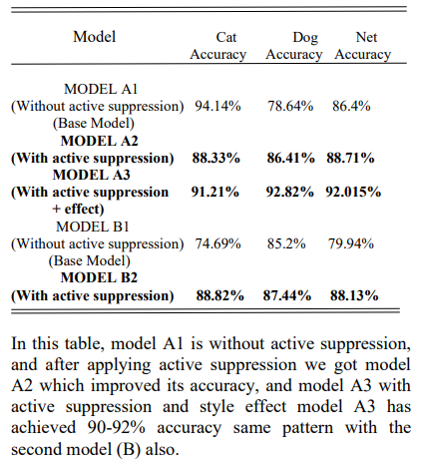
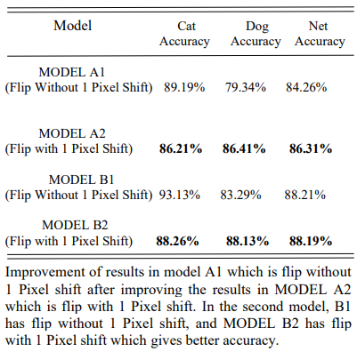
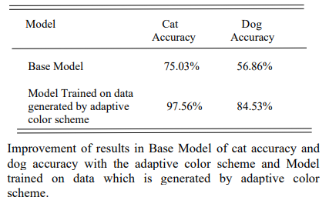
Experimental Results / Simulations / Observations
Results :
1 – Pixel Shift + Flip
Activation Suppression
Adaptive Color Scheme

Slide 26
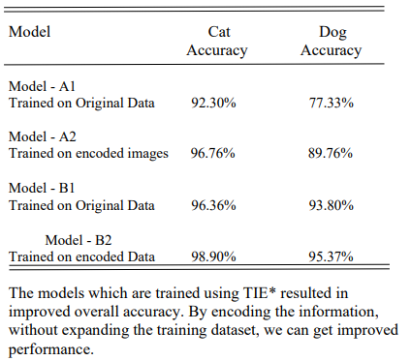
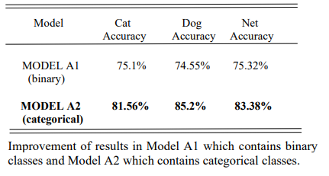
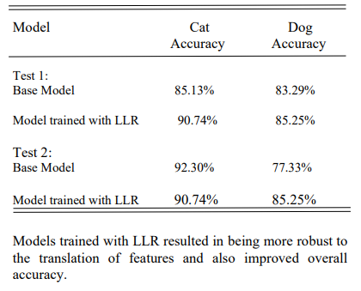
Experimental Results / Simulations / Observations
Results :
Tiles Shuffler
Low-level Residual
Texture Information Encoder

Slide 27
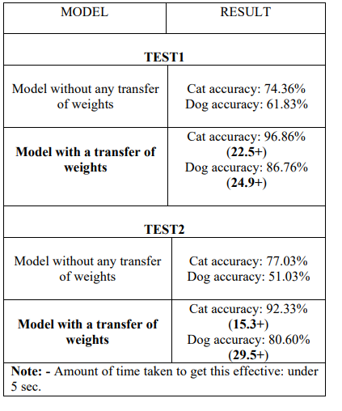
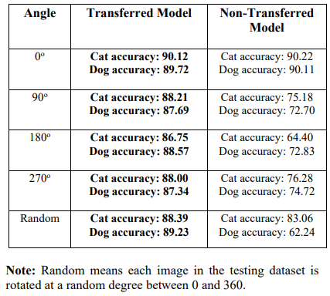
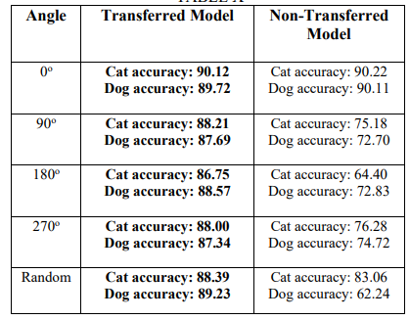
Experimental Results / Simulations / Observations
Results :
Rotational Invariance Test on Transferable Model (Model Size = 10 MB)
Rotational Invariance Test on Transferable Model (Model Size = 2.29 MB)
Color Invariance Test on Transferable model

Slide 28
Deliverable
Final Deliverables :
Python codes for each Augmentation technique and training methods developed and uploaded into the Git hub with all necessary documentation.
For each technique, batch execution is also included in the same notebook file.
Research paper is written and waiting for approval from mentors.
IP / Paper Publication Plan :
Regarding all Augmentation technique a single research paper is written with all necessary information and test results.
The idea of transferable model can be patented with the approval from mentors.
KPIs delivered/Expectations Met:
Thorough Literature survey is perform in the area of Image Augmentations and new 6 techniques are proposed.
Python codes for each of the technique are developed.
For each technique, the batch execution code is also included in the same file.

Slide 29
Work-let Closure Details
Code Upload details:
Items | Details
KLOC (Number OF Lines of codes in 000’s) | 0.810
Model and Algorithm details | For each technique different model and algorithms are used
Is Mid review, end review report uploaded on Git ? | Yes
Link for Git | https://github.ecodesamsung.com/SRIB-PRISM/CU_RSG32CU_Explore_and_Implement_Image_Augmentation_Options
Data details (if applicable):
Items | Data folder 1
Name & Type of Data (Audio/Image/Video) | Cat vs Dog
Number of data points | 25000
Source of Data (self collected, Scrapped, available on open source) | Kaggle (open source)
Google drive link/ git link to access data | https://www.kaggle.com/competitions/dogs-vs-cats/data
Note: If data uploaded on google drive, access to be shared to prism.srib@gmail.com

Slide 30
Thank you

